Slide 1
2023-24 Faculty Learning Communities

Slide 2
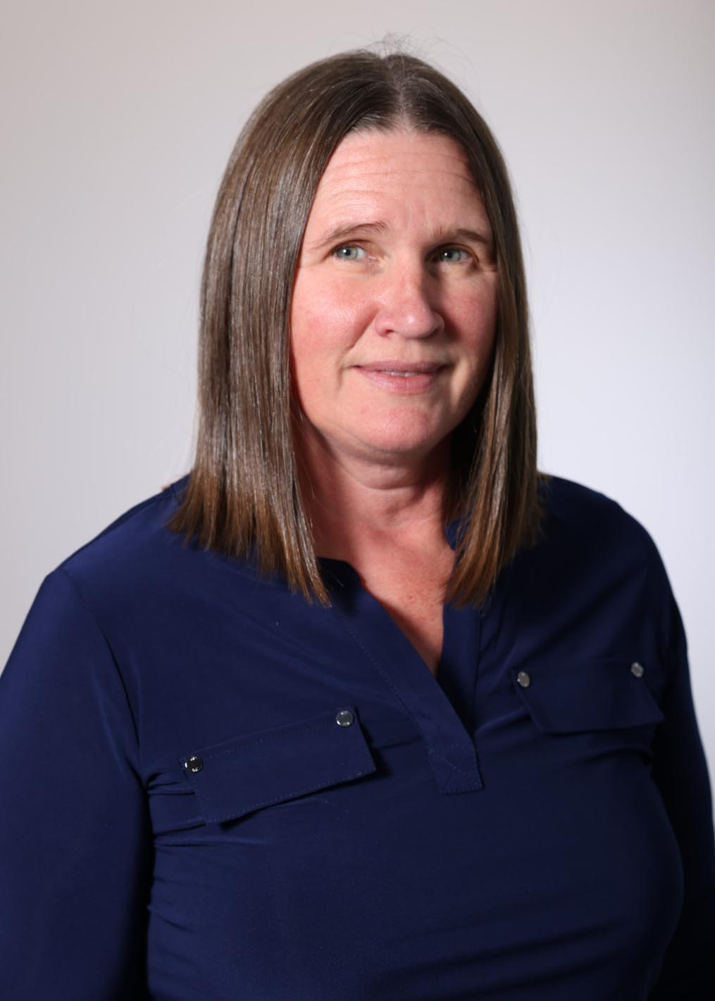
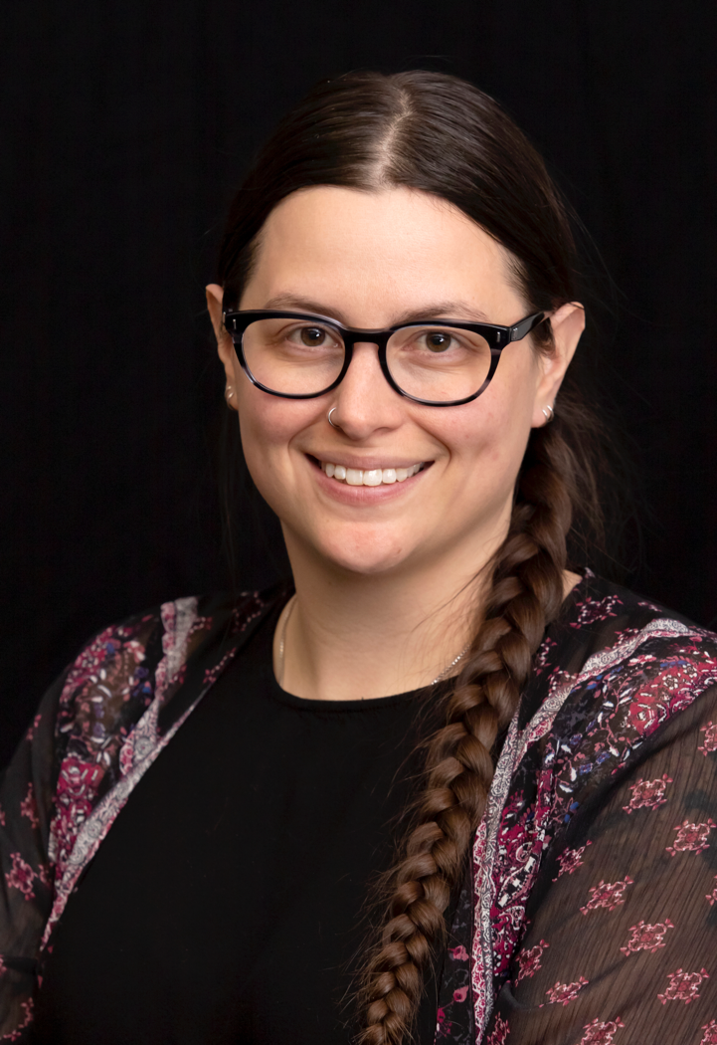
Integrating equity-based trauma-informed educational practices (TIEP) in the university classroom
Kathryn Young
School of Education
Perri Corvino
School of Social Work

Slide 3
Thinking through Trauma-Informed Educational Practices
This FSLC provided theory and practical ideas for integrating equity-based trauma-informed educational practices (ETIP) in university spaces.
6 staff and faculty members from GITA, Social Work, Communication Studies, Human Resources, Criminal Justice, Human Services and Counseling, and Education worked together to share ideas about and integrate TIEP into course policies, assignments, coursework, course content, team meetings, and departmental policies.
Focal Topics
What are trauma-informed educational practices?
What is stress and trauma?
How do stress and trauma affect students and instructors? What can we do to support students and ourselves?
How can faculty and staff implement trauma-informed education practices in their work, with students, with selves and with each other?

Slide 4
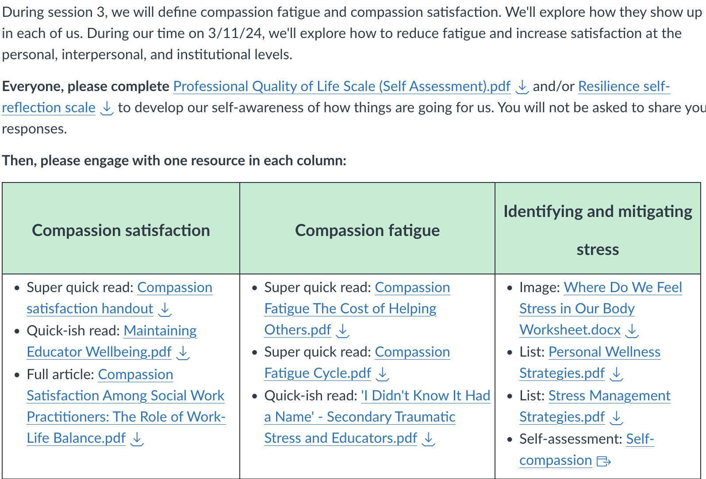
Modeling TIEP in the FSLC Canvas Shell
Notes:
The image is a screenshot of a document related to a session about compassion fatigue and compassion satisfaction. Here is a breakdown of the content:
Header
Session Topic: Defining compassion fatigue and compassion satisfaction, exploring their manifestations at personal, interpersonal, and institutional levels.
Date: 3/11/24
Goal: To reduce fatigue and increase satisfaction.
Instructions
Participants are asked to complete two assessments before the session:
Professional Quality of Life Scale (Self Assessment).pdf
Resilience self-reflection scale.pdf
Engagement Activities
Participants are asked to engage with one resource from each of three columns:
1. Compassion Satisfaction
Super quick read: Compassion satisfaction handout
Quick-ish read: Maintaining Educator Wellbeing.pdf
Full article: Compassion Satisfaction Among Social Work Practitioners: The Role of Work-Life Balance.pdf
2. Compassion Fatigue
Super quick read: Compassion Fatigue: The Cost of Helping Others.pdf
Super quick read: Compassion Fatigue Cycle.pdf
Quick-ish read: 'I Didn't Know It Had a Name' - Secondary Traumatic Stress and Educators.pdf
3. Identifying and Mitigating Stress
Image: Where Do We Feel Stress in Our Body Worksheet.docx
List: Personal Wellness Strategies.pdf
List: Stress Management Strategies.pdf
Self-assessment: Self-compassion

Slide 5
Our Evolving TIEP Practice Examples
What do you currently do? |  | What do you plan to do?
My courses allow for late submission of any coursework through the end of the term with small daily penalties |  | I am going to a small number of “extension days” that students may elect to use to extend the “on time” deadline for course assignments.
I introduce myself and the course before the course starts explaining group work, assignment deadlines and flexibility, etc. |  | I will be offering a more global policy on flexibility with assignments.
I require documentation if a student wants their absence excused |  | I’m planning on implementing a more equitable attendance/participation and late policy.
I have a policy statement and content about maintaining confidentiality with clients that uses absolute language. |  | I plan to add a statement of practice that explains my desire to maintain confidentiality but states the reality of risk and choice in choosing to share.

Slide 6
Interested in Facilitating an FLC?
Applications accepted throughout the year
Fill out an application on the CTLD website!

Slide 7
Culturally Responsive Teaching & the Brain
Facilitator:
Assoc. Professor Darcy Beery,
Technical Writing & Editing

Slide 8
Culturally Responsive Teaching & the Brain FLC
Closing the achievement gap of
culturally and linguistically diverse students …
by understanding the components necessary for
the brain to enter a state of cognitive alertness, …
thereby supporting students to move themselves
from dependent learners to independent learners.

Slide 9
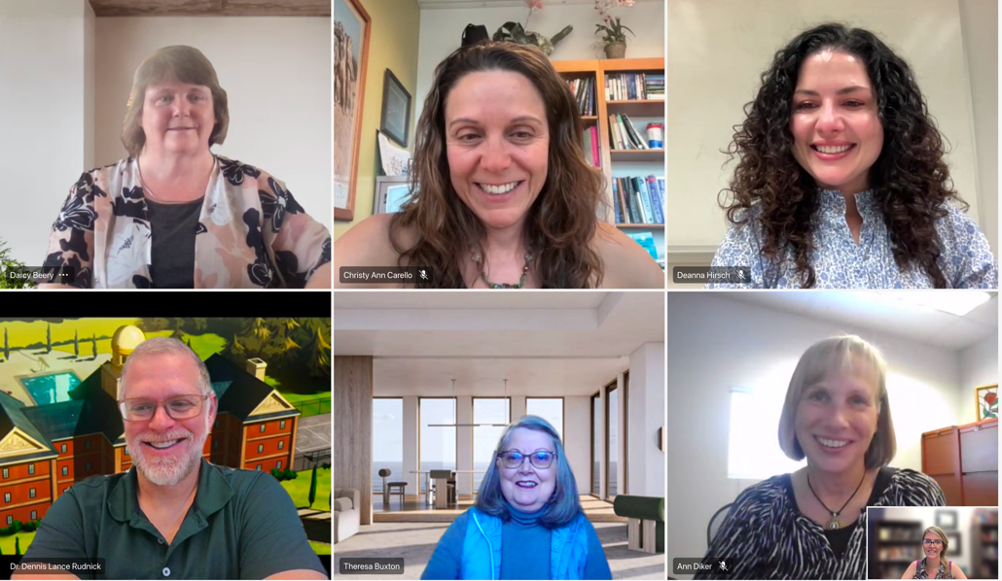
Participants
8 Faculty and Staff came together during the Spring 2024 semester to
learn and share about teaching and advising culturally diverse students.
Ann Diker, Nutrition
Deanna Hirsch, Public Relations
JT Kendall, Classroom to Career Hub
Dennis L. Rudnick, Elementary Education
Darcy Beery, Technical Writing
Theresa Buxton, Nursing
Christy Ann Carello, Biology
Jennifer Cheek, Criminal Justice & Criminology

Slide 10
Insights on Future Implementation
Recognize instructor implicit bias and stereotypes related to diverse generations and groups of student learners; and to engage in the work to eliminate these.
Validate students' experiences in the larger sociopolitical context.
Understand and provide the components in the classroom that create a truly safe learning space.

Slide 11
Insights on Future Implementation
Ask students to explain their studying strategies, instead of assuming they have them.
Support student learning strategies that develop and reinforce critical thinking skills through constructive feedback and student accountability for the work they produce.
Provide feedback which is instructive (rather than evaluative); meaning it is specific, in the right dose, timely, and delivered in a low stress, supportive environment.

Slide 12
Interested in Facilitating an FLC?
Applications accepted throughout the year
Fill out an application on the CTLD website!

Slide 13
Fundraising Academy FLC - Spring 2024

Slide 14
Purpose of the Fundraising Academy
To build relationships between University Advancement and faculty/staff
To help faculty/staff learn the fundraising process at MSU Denver
To assist FLC Members in developing their fundraising ideas and create an implementation plan

Slide 15
Fundraising Academy FLC Participants
Cath Kleier, Associate VP of Faculty Affairs.
Matt Jenkins, Faculty, Art
David Lamothe, Asst Dir. of Sports, Campus Recreation
Adrienne Martinez, Assoc. VP, C2Hub Initiatives
Rachel Hawley, Staff, Student Academic Services.
Inge Wefes, Faculty, Associate VP for Graduate Studies
Nona Shipman, Co-Director, One World One
Megan Hughes, Faculty, Director, Honors Program
Katie Strain, Faculty, Lab Manager, Brewery Operations
Kristy Duran, Faculty Dir. of Undergraduate Research
Elizabeth Kleinfeld, Faculty, Writing Center Director
Elizabeth Parmelee, AVP for Undergraduate Studies
Lauren Koppel, Assoc Director of Scholarship Support & Retention
Lillian Manygoats, Dept Coordinator, Centers and Programs
Theresa Buxton, Faculty, Nursing Department Chair
Sara Jackson Shumate, Dir. Center for Individualized Learning
Jo Erven, Director of the Center for Internal Audit
Gina Cook, Director of International Business programs
Chris Jennings, Dept Chair of Journalism and Media Production
April Schofield, Dir Center for Professional Selling
Caitlin Fine, Faculty, Elementary Education and Literacy
Britt Lane, Faculty Dir. of Graduate Programs-School of Ed.
Mike Hengst, Faculty, Music
Clay Daughtrey, Faculty, Marketing, Facilitator of FLC
Raenea Gomez, Policy and Process MGR, Graduate Studies
Shayla Bischoff, Staff, Assistant to AVP for Undergraduate Studies

Slide 16
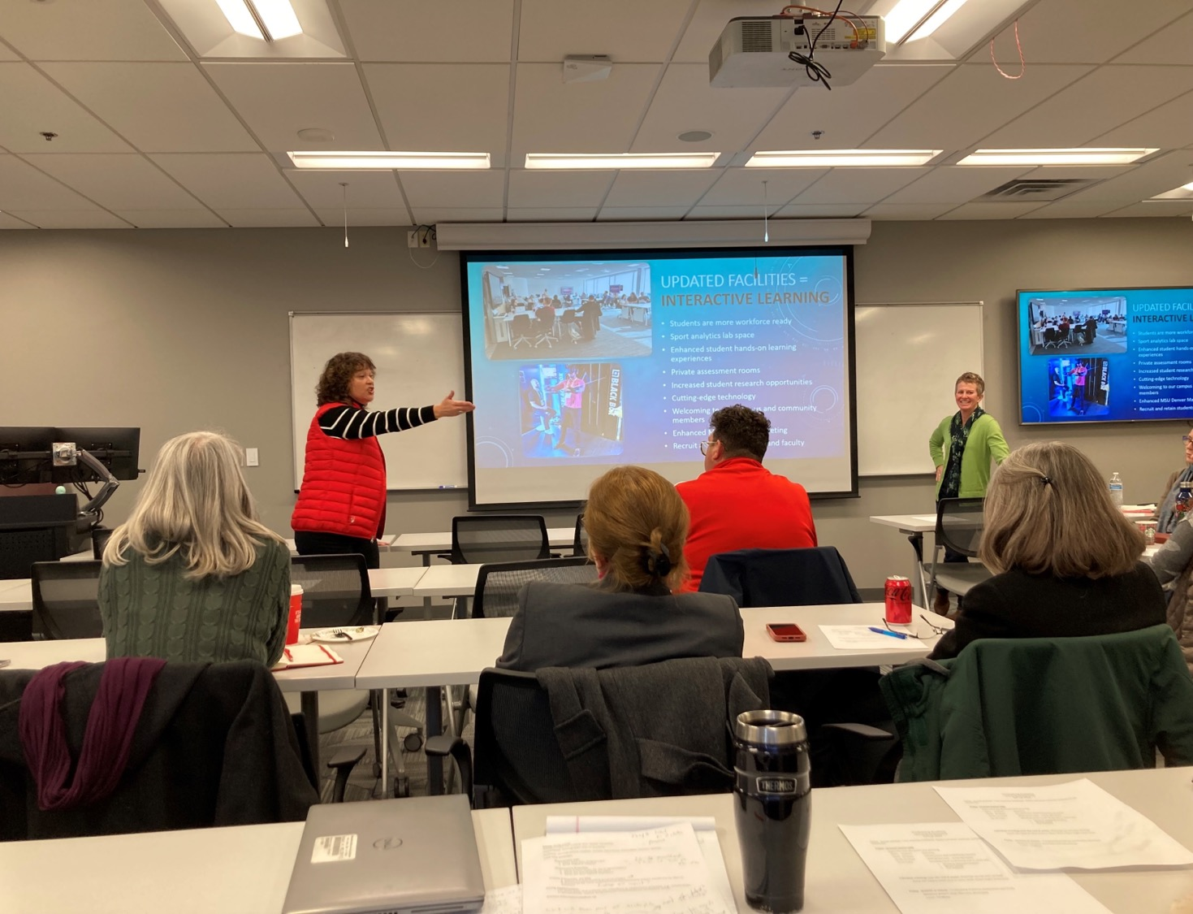
Fundraising Academy FLC - Presenters
Susan Bertelsen, 2022-23 Faculty Fellow
Brandi Rideout, Sr. Director of Alumni Engagement
Evann Coad, Asst Director Of Annual Giving
Zacary Tardiff, Exec. Dir. Of Corporate and Foundation Relations
Genevieve Laca, Sr. Director of Major Gifts
Timothy Hawkins, Proposal Development Specialist - OSRP
Christine Marquez-Hudson, VP of University Advancement

Slide 17
Fundraising Academy Progress
Thirteen FLC members are currently meeting with UA staff to develop and implement their fundraising ideas.
A majority of participants wanted to learn about UA and the Fundraising process. Will consider fundraising in the future.
University Advancement considering offering another Fundraising Academy in the future.

Slide 18
Interested in Facilitating an FLC?
Applications accepted throughout the year
Fill out an application on the CTLD website!

Slide 19
Scholarship of Teaching and Learning (SoTL) FLCs
Focused on scholarly exploration of a specific teaching and learning topic or question.
Members of a SoTL FLC commit to working together during 2-3 semesters to conduct a SoTL study or create a piece of SoTL scholarship together.
3 SoTL FLCs occurred in 2023-24

Slide 20
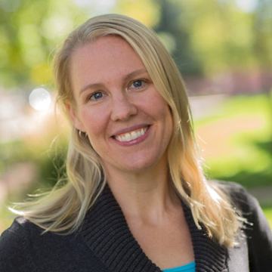
SoTL FLC Explorations of Multimodal Pedagogies in Online, In-Person, and Hybrid Courses through Self-Study
Facilitator
Ingrid Carter, Professor of
Elementary Education
Members
Letitia Pleis, Professor of Accounting
Paris Prestridge, Assistant Professor of Health Professions
Michele Trujillo, Associate Professor of Special Education
Tina Herring, Professor of Special Education

Slide 21
SoTL FLC Explorations of Multimodal Pedagogies in Online, In-Person, and Hybrid Courses through Self-Study
What is Self-Study?
Self-study is a methodology wherein the educator explores their own teaching with the intent of reflection and insight to improve their practice.
Self-study is action-oriented and allows the instructor to examine multiple perspectives of “self.” Thus, the purpose of self-study is reflective, it inspires change and improvement to one’s practice, and it provides pedagogical insights to others (Pithouse, Mitchell, & Weber, 2009).

Slide 22
SoTL FLC Explorations of Multimodal Pedagogies in Online, In-Person, and Hybrid Courses through Self-Study
Research question: In what ways can we holistically elevate student experiences in the online/hybrid/hyflex courses we teach?
Delved into self-study literature
Discussed our values and goals for our online/hybrid teaching
Reflecting on our students and how to elevate their experiences
Read and discussed books about “ungrading”
Collected data
Individual Teaching Journal (typically at least one entry per week for each of the 15 weeks of the semester)
Critical Friends Meeting Recordings (~every 2 weeks throughout entire 15-week semester, 8 one-hour meetings total)
Course Assignment Description and Rubric

Slide 23
SoTL FLC Explorations of Multimodal Pedagogies in Online, In-Person, and Hybrid Courses through Self-Study
Submitted conference proposal:
Carter, I., Prestridge, P., Trujillo, M., Pleis, L., & Herring, T. (submitted). Exploring assessment and feedback to elevate students' experiences in online and hybrid courses: A collaborative self-study. Proposal submitted for the 31st Annual Scholarship of Teaching and Learning Summit, virtual.

Slide 24
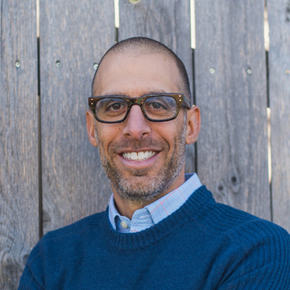
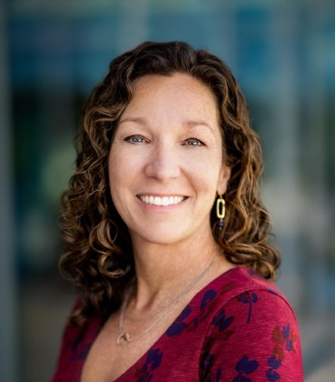
SoTL FLC Faculty Perceptions on Grading and Assessment
Co-Facilitators:
Philip E. Bernhardt, Professor of Secondary Education
Bridget Arend, Assoc Director of Teaching & Learning, CTLD
Members:
Dennis Rudnick, Elementary Education
Mark Koester, Mathematics
Mehpara Qadir, Graduate Student, Education

Slide 25
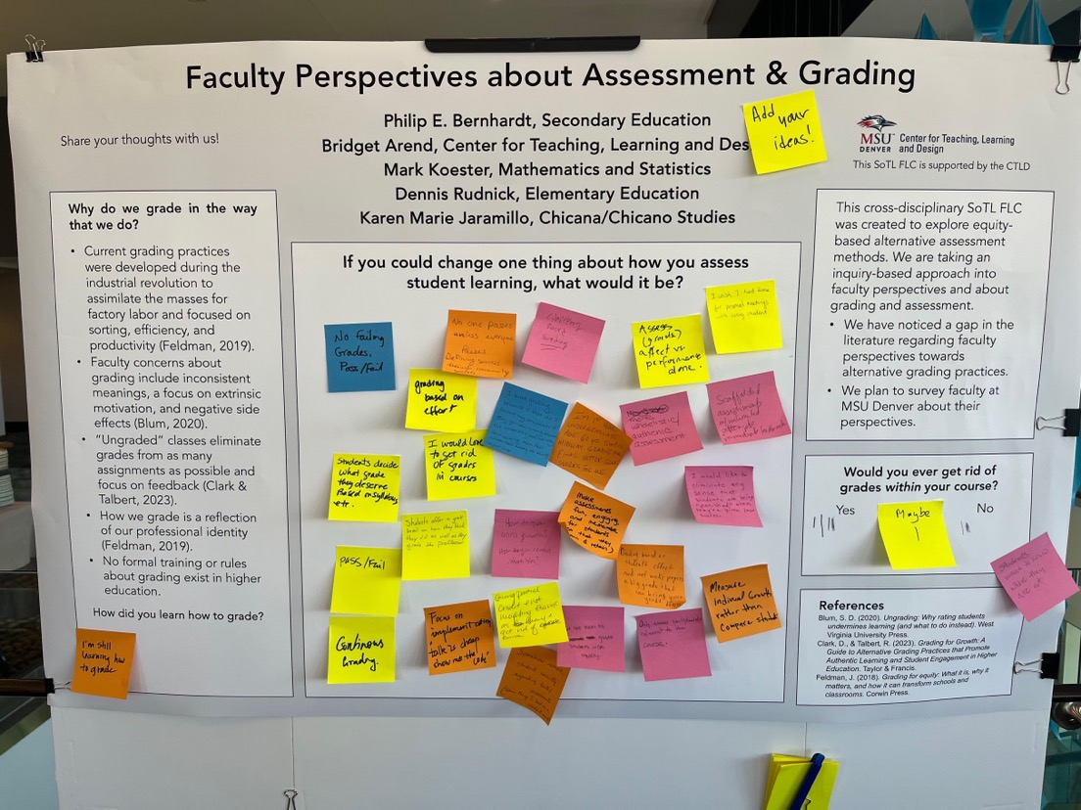
SoTL FLC Faculty Perceptions on Grading and Assessment
Gathered ideas at the MSU Denver Research Symposium

Slide 26
SoTL FLC Faculty Perceptions on Grading and Assessment
Developed a survey to investigate faculty perspectives on changing grading and assessment practices within higher education institutions (184 responses)
What are faculty perspectives about changing their grading and assessment practices?
What institutional and cultural factors inform faculty to change their grading and assessment practices?
How might faculty sociological understandings and personal beliefs (ontoepistemic heritages) inform how they consider equity in their grading and assessment practices?
Proposal accepted to the 5th Annual Grading Conference!

Slide 27
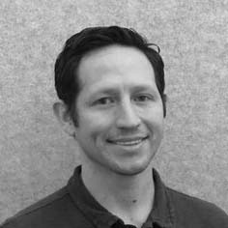
SoTL FLC Exploring the Use of Generative AI for Teaching and Student Engagement
Facilitator: Steve Geinitz,
Computer Science
Members:
Ranjidha Rajan, Computer Science
Smita Singh, School of Hospitality
Kwabena Peprah, Marketing
Kathryn Crim Shrumm Schmidt, Philosophy
Sam Jay, Communication

Slide 28
SoTL FLC Exploring the Use of Generative AI for Teaching and Student Engagement
Phase I
The Instructional Review Board-approved survey was developed by Smita Singh, Ph.D., assistant professor; Ranjidha Rajan, Ed.D., professor; Steve Geinitz, Ph.D., assistant professor; and Samuel M. Jay, Ph.D., director of Faculty Affairs. Its aim was to understand faculty perception, use and nonuse of generative AI for educational purposes.
Phase II
The second phase (Project 2) of data collection is underway and focuses on how generative AI is being integrated into classroom assignments.
This portion of the research project is a longitudinal study aimed at uncovering how students’ perceptions of generative AI in the classroom change over time and is led by Rajan and Geinitz, as well as Kate Schmidt, Ph.D., and Kwabena Peprah, DBA.

Slide 29
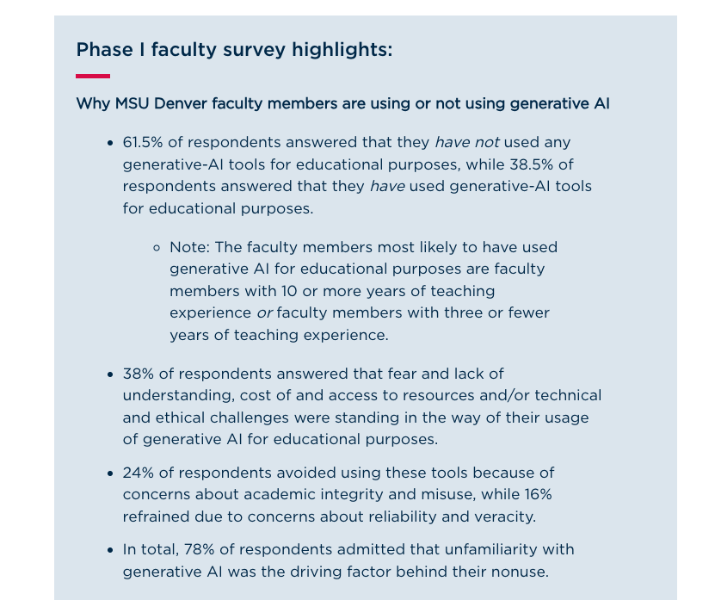
SoTL FLC Exploring the Use of Generative AI for Teaching and Student Engagement

Slide 30
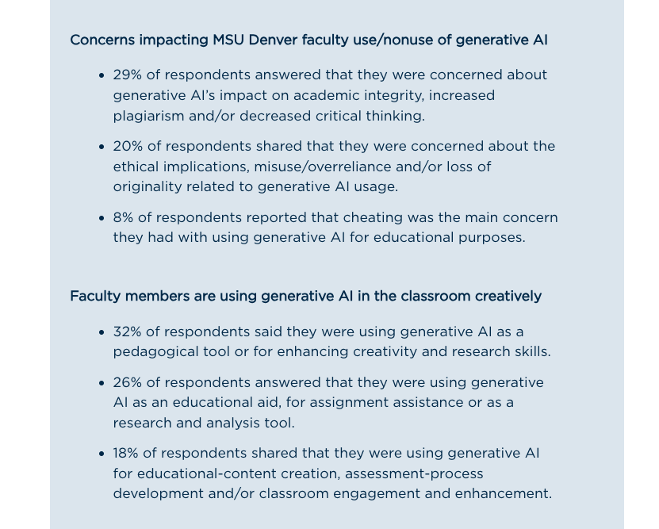
SoTL FLC Exploring the Use of Generative AI for Teaching and Student Engagement

Slide 31
We are currently recruiting SoTL FLC Facilitators for 2024-2025!
Looking for facilitators to lead a scholarship project about:
Crafting Assessments in the Age of AI
Setting Appropriate and Equitable Boundaries with Students
Student Engagement in Asynchronous Courses
Or other ideas proposed by faculty!
Interested? View the CTLD website and contact Bridget Arend with questions or to suggest a project.

Slide 32
Interested in Facilitating an FLC?
Applications accepted throughout the year
Fill out an application on the CTLD website!

Slide 33
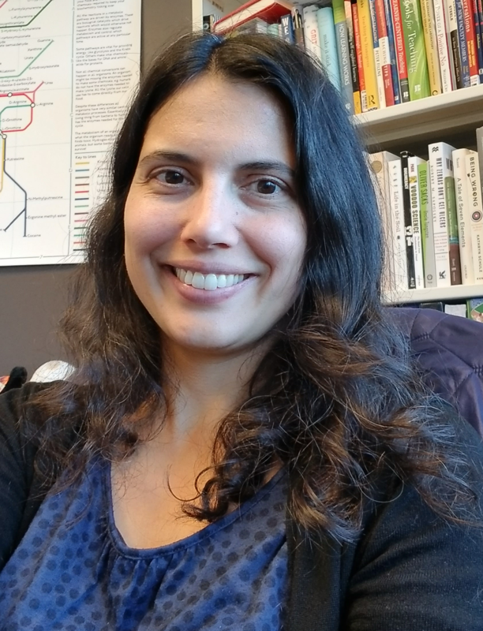
Open Educational Resources (OER) FLC Facilitators
Emily Ragan
Chemistry and Biochemistry
Brian Healy
Communication Studies

Slide 34
What are Open Educational Resources?
OER are free teaching, learning, and research materials that have been licensed in a special way so that faculty can adopt or adapt them for their students.
open = free + permissions
(to keep, use, copy, share, edit, and remix!)

Slide 35
How can faculty benefit from the OER FLC?
Seven session FLC, 1.5 h sessions on Teams
Introduction to OER and open licensing; searching for OER
Tools that work well with OER (hypothesis, GoReact, etc.)
Open Pedagogy: how can we engage our students as scholars in authentic (rather than disposable) assignments?
Presentations from fellow faculty using OER: Felix Flores, Marketing (F23) and Alycia Palmer, Chemistry (Sp24)
Presentations from guest speakers: Meggie Mapes of KU and Alex McDaniel in Fall 23; Lindsey Schreiber of the CTLD in Spring 24
Sessions with OER PR Intern (Jake Smith Fall 2023, Bri Mangiamele in Spring 2024)
Last two sessions: faculty share out about their projects. This part is always so much fun!

Slide 36
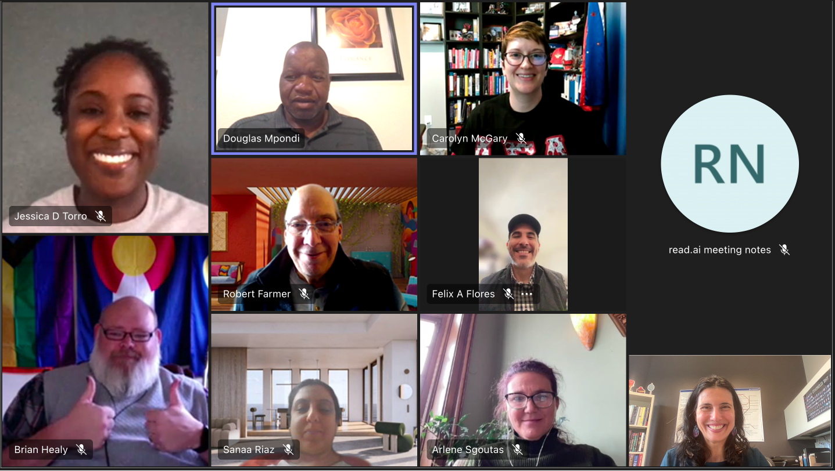
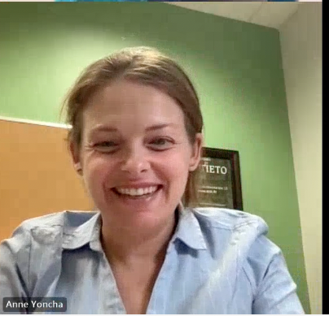
Fall 2023: Nine faculty from Art, Africana Studies, Engineering, GWS, Marking, Nutrition, & Sociology and Anthropology; 2 facilitators

Slide 37
Spring 2024: 12 participants and 2 facilitators from CTLD, Chemistry, Communication, Engineering, Health Professions, Music, Psychology, & Hospitality

Slide 38
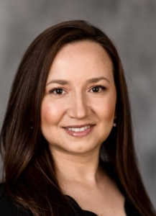
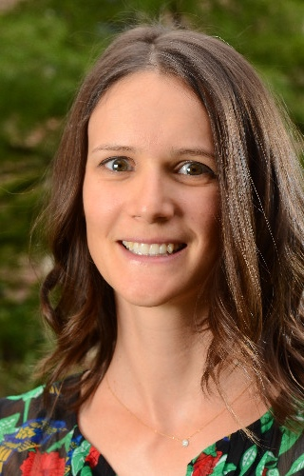
Exploring Translanguage Possibilities in MSU Denver Courses FLC
Lina Martin Corredor
School of Education
Caitlin Fine
School of Education

Slide 39
What communicative resources count for learning in MSU Denver courses? Exploring translanguaging possibilities
15 faculty members from Education, Psychology, French & Geology came together to learn about translanguaging as a linguistic justice imperative & how to welcome it through pedagogical designs.
Focal Topics
What is translanguaging?
How can I get to know my students’ language profiles?
What are translanguaging stances and why are they important?
What is the multilingual ecology of my department / building?
What are translanguaging pedagogical designs and how can I modify my course syllabi to welcome translanguaging?
What are colleagues doing to welcome translanguaging into their courses at other universities?

Slide 40
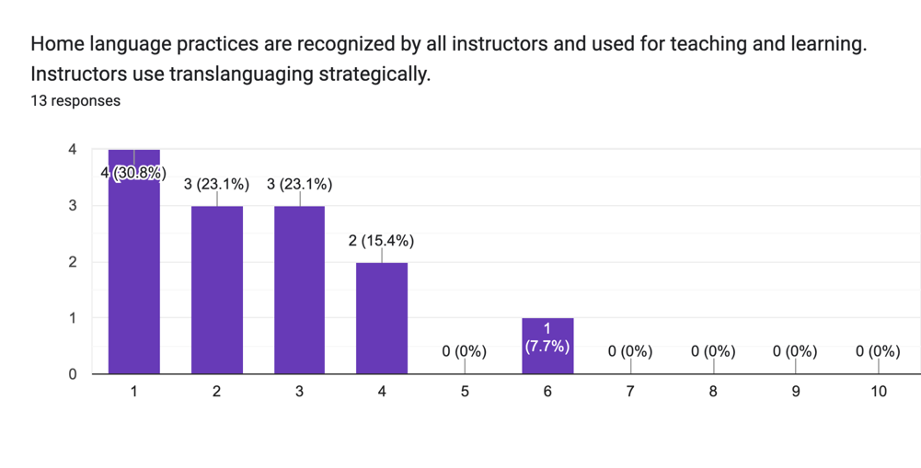
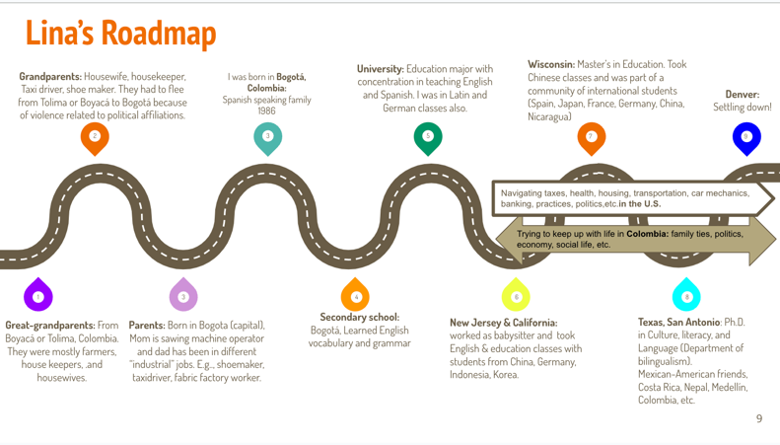
What communicative resources count for learning in MSU Denver courses? Exploring translanguaging possibilities
Highlights
Completing multilingual ecology questionnaires for our departments / buildings
Creating and sharing our own language profiles
Notes:
Image 1: Lina's Roadmap
Roadmap Details
The roadmap is divided into various points along a winding path, each marked with a colored icon and a description:
Great-grandparents
Role: Household, housekeeper
Language: Spanish
Location: Small town in Colombia
Education: No formal education
Job: Housekeeper for a family
Grandparents
Role: Factory worker
Language: Limited English
Location: Colombia
Job: Railroad worker, factory worker
Parents
Birthplace: Bogotá, Colombia
Language: Limited English
Education: Learned English, attended school in the U.S.
Job: Sewing machine operator in a garment factory
Lina
Birthplace: Bogotá, Colombia
Language: Spanish
Family: Migrated to the U.S.
Secondary School
Experience: Regular schooling
Language: Learned English vocabulary and grammar
University
Major: Education
Experience: Worked with bilingual/ESL and English as a Second Language classes
Location: Texas
Wisconsin
Degree: Master's in Education
Experience: Took Chinese classes and was part of a community of international students (Chinese, Korean, Germany, Ghana, and others)
Family: Learned some Spanish from Lina's Colombia family
New Jersey & California
Experience: Worked in childcare and taught English in California and New Jersey
Interaction: Learned from immigrant families (Honduras, Korea, and others)
Texas, San Antonio
Degree: Ph.D. in English Education
Family: Daughter of Mexican immigrants
Experience: Teaching English in San Antonio and interacting with migrant families from Mexico, Colombia, etc.
Additional Information
Hobbies and Interests:
Keeping up with trends in Colombia family life
Watching movies, TV, learning about current trends in music, transportation, banking practices, politics in the U.S.
The roadmap provides a detailed narrative of Lina's family history, educational journey, and professional experiences, highlighting the multicultural and multilingual aspects of her life.
Image 2: The image is a bar chart displaying survey responses regarding the recognition and strategic use of home language practices by instructors for teaching and learning. The title of the chart states:
"Home language practices are recognized by all instructors and used for teaching and learning. Instructors use translanguaging strategically."
Chart Details
Number of Responses: 13
Response Scale: 1 to 10
Response Distribution
1: 4 responses (30.8%)
2: 3 responses (23.1%)
3: 3 responses (23.1%)
4: 2 responses (15.4%)
5: 0 responses (0%)
6: 1 response (7.7%)
7: 0 responses (0%)
8: 0 responses (0%)
9: 0 responses (0%)
10: 0 responses (0%)
Visualization
The bars are purple and represent the frequency of responses for each value from 1 to 10.
The chart indicates a majority of the responses are clustered between 1 and 4, with one response at 6 and none above 6.
Interpretation
A significant portion of respondents (77%) rated the statement between 1 and 4, indicating a general perception that home language practices are not widely recognized or strategically used by instructors.
A smaller portion (7.7%) rated it as 6, suggesting some recognition but not widespread.
No respondents rated the statement between 7 and 10, implying a strong consensus that home language practices are not fully integrated into teaching and learning by all instructors.

Slide 41
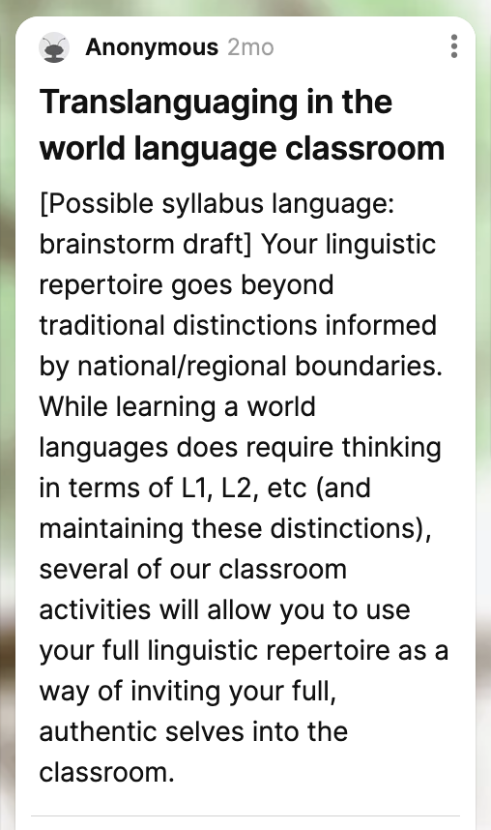
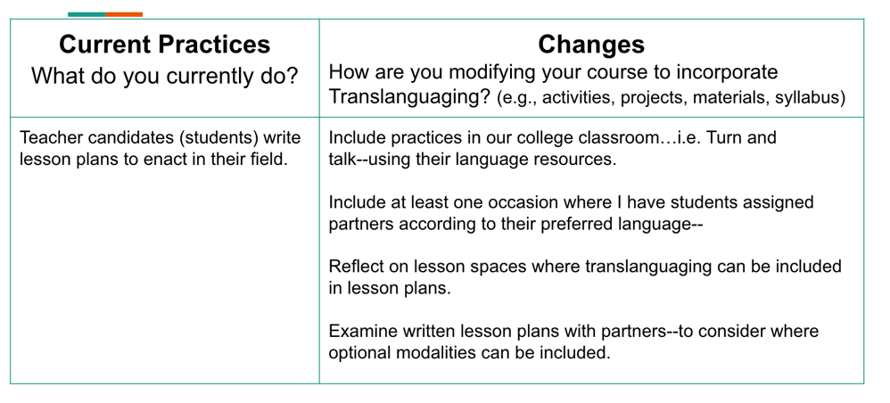
What communicative resources count for learning in MSU Denver courses? Exploring translanguaging possibilities
Highlights
Naming our translanguaging stances
Planning syllabus changes for Fall 2023
Chatting with colleagues from UT Austin, UT San Antonio & UT Rio Grande Valley

Slide 42
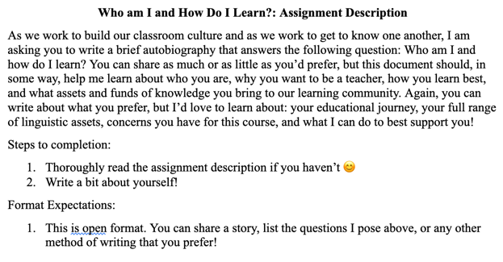
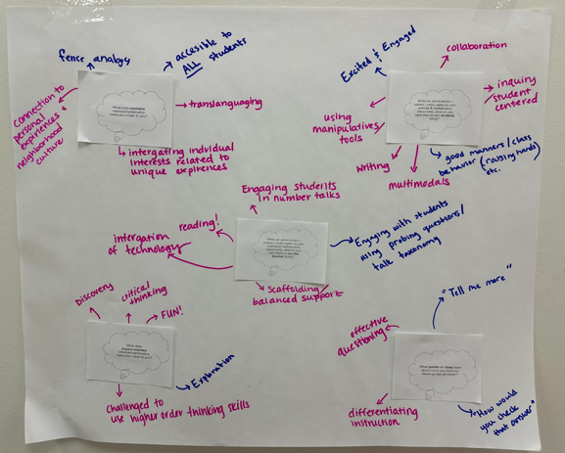
How can we create more inclusive and equitable spaces for teaching and learning that honor, explore, and extend the cultural, linguistic and literacy practices of students?
Implementation of self-created goals
Syllabi modifications
Design of class resources and activities
Translanguaging instruction
Collaborative research
Reflections on learning experiences
Future directions at the micro & macro levels

Slide 43
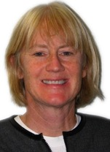
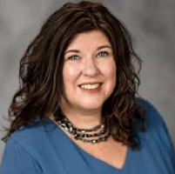
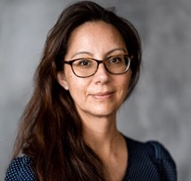
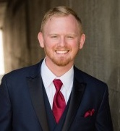
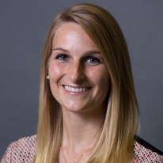
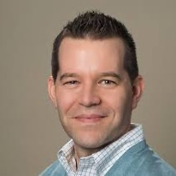
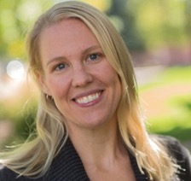
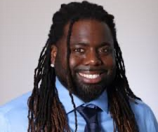
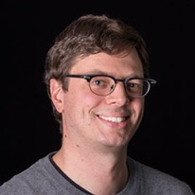
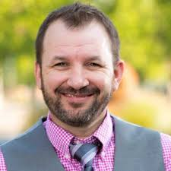
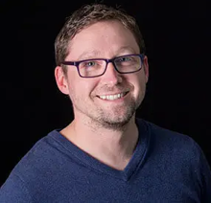
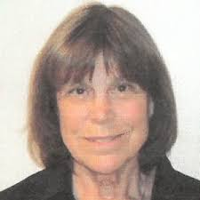
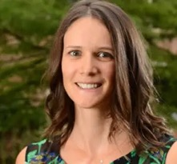
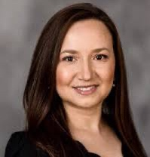
Participants
Susan Arendt
Krista Griffin
Maria Magallanes
Daniel Moore
Andreea Prundeanu-Thrower
Cassandra Bailey
Corey Sell
Ingrid Carter
Andrew Walton
Chad Mortensen
Aaron Richmond
Chris Garris
Barb EchoHawk
Caitlin Fine
Lina Martín-Corredor

Slide 44
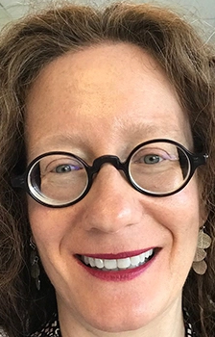
Benefits and Logistics of an Interdisciplinary Disabilities Studies Minor FLC
Cristina Foust
Communication Studies
Elizabeth Kleinfeld
English
Notes:
Not attending: Elizabeth Kleinfeld

Slide 45
The Benefits and Logistics of an Interdisciplinary Disabilities Studies Minor at MSU Denver: An Exploratory FLC
We included faculty, staff, and students in discussions
Members: Alexis Bachik, Zach Clark, Melissa Cermak, Jeanne Connelly, Julie Clockston, Sonny Dhoot, Corey Hecker, Lisa Kirsch, Elizabeth Kleinfeld, Owen Rigot, Anahi Russo, Marcia Walsh-Aziz
Read Alice Wong’s Disability Visibility (an anthology of essays and poetry by disabled people) and Margaret Price’s Mad at School (scholarly book about neurodiversity in academia)

Slide 46
The Benefits and Logistics of an Interdisciplinary Disabilities Studies Minor at MSU Denver: An Exploratory FLC
Highlights:
Explored models and how to make the minor accessible
Created a minor in Disabilities Studies that is available through the IDP

Slide 47
Interested in Facilitating an FLC?
Applications accepted throughout the year
Fill out an application on the CTLD website!

