Slide 1

ADVISING
SYSTEMS

Slide 2
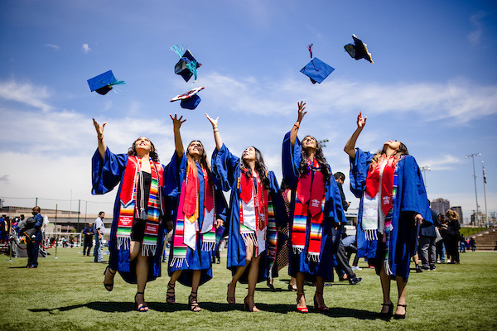
Explanation of Advising Systems
We support advising teams across campus!
  We are part of Undergraduate Studies in Academic Affairs
  Along with leadership in colleges, schools, and programs, we help manage MSU Denver’s undergraduate advising structure.
  We don’t supervise advisors/leads or directly advise students outside of those on Academic Standing.
  We keep advisors informed and connected.
  We develop and implement strategy, training, and development, and manage Navigate360.

Slide 3
WHAT WE DO
1
2
3
Advising Strategy, Training, and Development
Early Alerts and Academic Standing
Navigate360 Management
Notes:
Advising Systems is a department housed within Undergraduate Studies and is a part of Academic Affairs here at MSU Denver. We are an academic advising program that manages, in collaboration with our colleges, schools, and programs, multiple aspects of MSU Denver’s hybrid, decentralized undergraduate advising structure. We help ensure that consistency and communication exists across all of the academic advising teams. The units within Advising Systems foster connections across MSU Denver’s stakeholders committed to the academic support of student retention through graduation by way of leadership, collaboration, coordination, and implementation. Our area develops and implements advising strategy, training, and development. We also manage the Early Alert program, the academic standing policy, and the SSC Navigate system. Get to know us!

Slide 4

OUR ROLES
Stephanie Allen- Director
Kimberly Williams - Associate Director, Intervention Services
Brandy Swanson - Coordinator for Training and Development
Patrick Wise - Advising Coordinator, Intervention Services
Heather Collins - Coordinator for Technology and Support
Student Staff

Slide 5
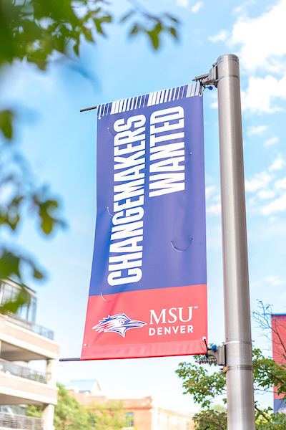

STRATEGY, TRAINING, AND DEVELOPMENT
  New Advisor Onboarding
  University-wide Advising Initiatives
  Provide input on policies and procedures
  Professional Development opportunities and ongoing training
  Collaboration, leadership, and communication to help fulfill goals of the University

Slide 6
EARLY ALERTS AND ACADEMIC STANDING
  Create, send, and manage Early Alert campaigns to faculty
  Support students on Academic Notice (formerly Warning), Academic Recovery (formerly Probation), and Academic Suspension
  Staff can lift Recovery and Suspension Encumbrances

Slide 7
NAVIGATE 360 MANAGEMENT
  Train faculty and staff on Navigate360
  Troubleshoot Issues
  Behind-the-scenes configurations
  Launch new features
  Leverage tech to support student success

Slide 8
OTHER SUPPORT
  Schedule appointments for Student Intervention Services Staff (Students on warning or recovery status may also meet with their professional academic advisor.)
  Help direct students to appropriate advisors, resources, or offices. Note: Referring students first to their academic department, academic advisor, or appropriate office is a great way to beat the Roadrunner Runaround!
  We are not able to manage appointments for all advisors across campus.

Slide 9


RESOURCES
FOUND ON THE ADVISING WEBSITE:
ADVISOR LIST
ADVISING RESOURCES FOR STUDENTS ON WEB
TUTORIALS
FAQS
msudenver.edu/advising

Slide 10
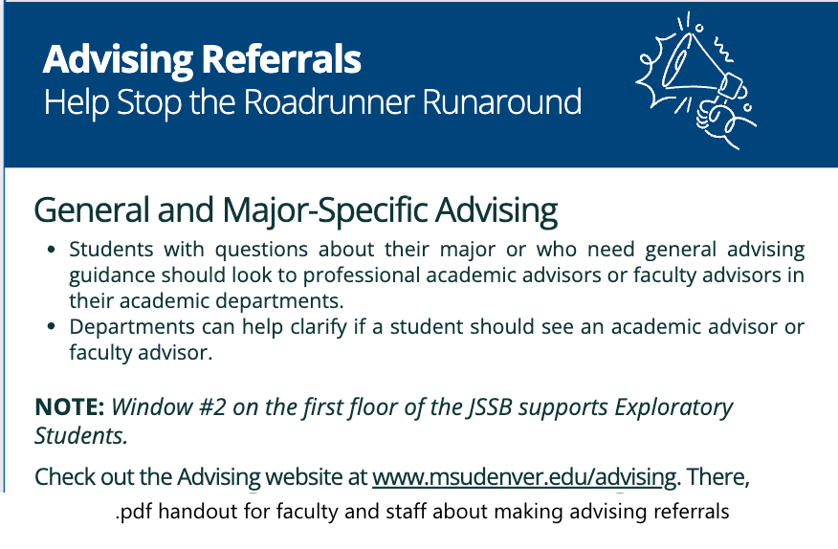
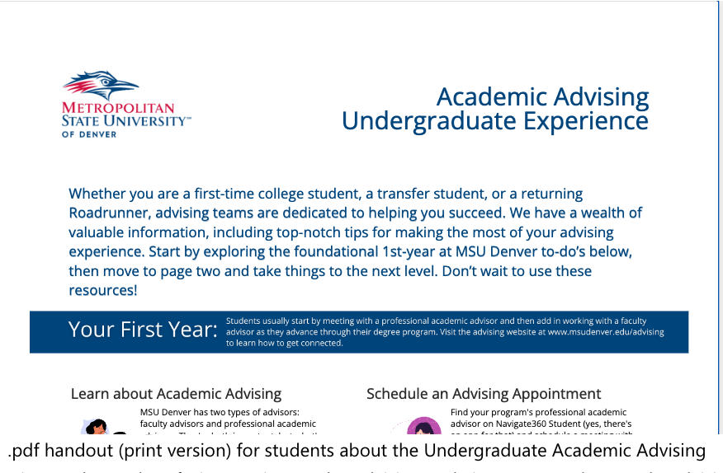
Making Referrals and Advising Experience Screenshots
MAKING REFERRALS
ADVISING EXPERIENCE

Slide 11
Thank you Page
THANK
YOU
We couldn’t do what we do...without you!
Advising Systems
advisingsystems@msudenver.edu
303-605-5650
Student Intervention Services
sis@msudenver.edu
303-605-5644
www.msudenver.edu/advising

